Slide 1
Sales analysis
Muzzammil Mulla
Tableau link:
tabeau/muzzammil/dashboard

Slide 2
By Sales
Sales is best output to predict the growth of the organization.
by Orders
With the help of orders we can find out demand of product.
By Region
By region we can target different countries for marketing and advertisement.
By Deal size
Deal size matters when profit is first priority.

Slide 3
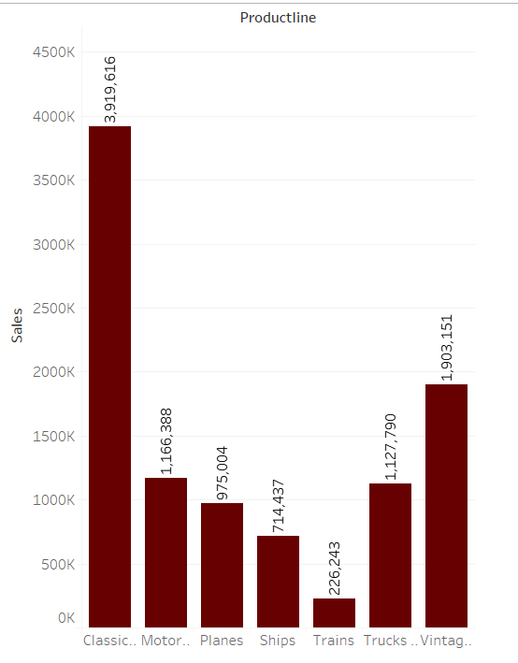
sales

Slide 4
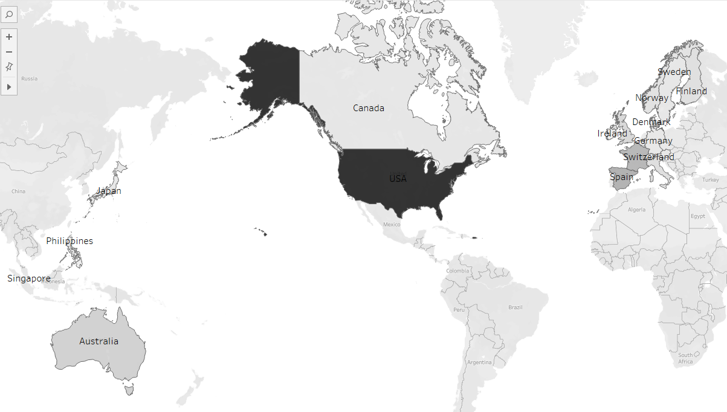
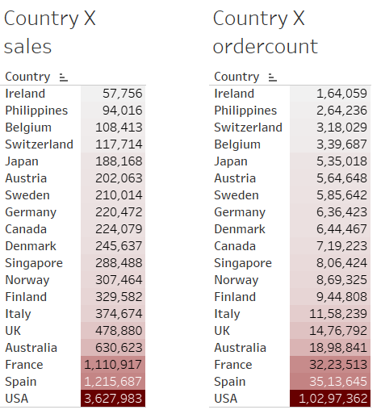
Region

Slide 5
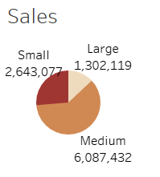
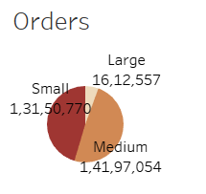
Deal size matters……!
In this Analysis I found that cancellation rate of larger deal is zero.
Surprisingly, medium deal size have more cancellation that is 20% more than small deals.

Slide 6
Insights
Want more focus on big deals, because cancellation rate is zero.
USA is big market for each product.
Medium deals has more profit.
Cars generate more revenue

Slide 7
Thank you………!

